Slide 1


SQL DATA ANALYSIS
Safaricom Stock Prices Analysis Case Study
Ziana Otoyi | 2024

Slide 2

1
OBJECTIVES
Use SQL queries to understand and analyze Safaricom’s historical stock prices.
Learn advanced SQL techniques for data analysis.
Identify and calculate key performance indicators (KPIs).
Derive actionable insights for decision-making.
NexTech Academy 2024

Slide 3

2
SCENARIO
You are a data analyst at Safaricom's Investment Research department. The company's management is keen to understand the historical performance of their stock price from 2012 to June 2019. They're looking for insights to inform future investment decisions and strategic planning.
NexTech Academy 2024

Slide 4

WHAT THEY WANT TO KNOW
3
Market Trends
How have Safaricom's stock prices fluctuated over the past seven and a half years? Are there any seasonal patterns or long-term trends we can identify?
NexTech Academy 2024
Performance Analysis
What were the average opening, closing, high, and low prices during this period? Understanding these key metrics will help us gauge overall market sentiment.

Slide 5
THEY ALSO WANT TO KNOW..
4
Volatility & Risk
Volume Insights
How volatile has the stock price been? Analyzing standard deviation will give us a picture of the risk associated with investing in Safaricom.
Was there a correlation between trading volume and price movements? Higher volume days might indicate periods of increased investor interest or market activity.
NexTech Academy 2024
Extremes
Did Safaricom experience any significant price spikes or dips? Knowing the dates and corresponding prices associated with these events could be valuable for future analysis.

Slide 6

5
DATASET OVERVIEW
Daily stock prices from 2012 to June 2019.
Columns: ID, Date, Open, High, Low, Close, Volume, Change %
NexTech Academy 2024
Stored in a .csv file named safcom_stocks.csv

Slide 7

KEY FINANCIAL TERMS
6
Stocks- In the world of finance, a stock (also called a share) represents a unit of ownership in a corporation. When you buy a stock, you're essentially purchasing a tiny piece of the company.
Open -The price at which the stock starts trading when the market opens. The NSE trading hours are typically from 9:00 AM to 3:00 PM East Africa Time (EAT).
High- The highest price the stock reaches during the trading day.
Low - The lowest price the stock reaches during the trading day.
Close: The price at which the stock ends trading when the market closes.
Volume: The total number of shares traded during the day.
Change %: The percentage change in the stock price from the previous trading day.
Moving Average: technique used to continuously calculate the average price over a specific period of time.
NexTech Academy 2024

Slide 8
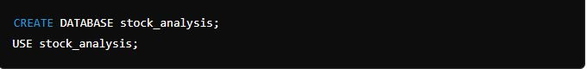

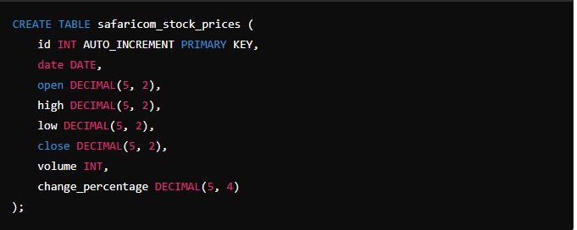
CREATING THE DATABASE AND TABLE
5
We first need to create a database to store our stock price data. A database is like a digital filing system where we can organize and manage our data.
NexTech Academy 2024
Then, we create a table to hold the stock prices. Think of a table as a spreadsheet with rows and columns, where each row represents a day of stock prices.
Remember to Refresh the schemas

Slide 9
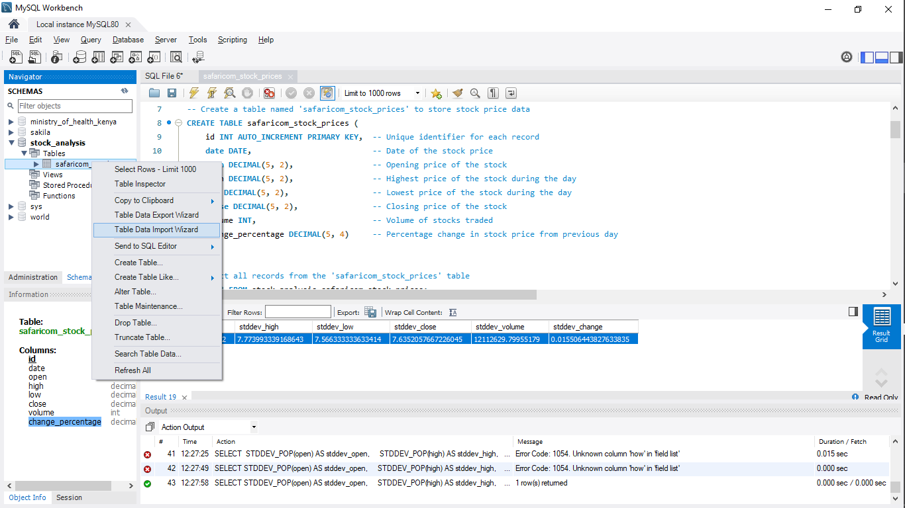

LOAD DATA
8
Once, our Database and Table are ready, we Proceed to Loading the .csv file with the dataset.
Right click on the safaricom_stock_prices table we just created, then select Table Data Import Wizard, Select File to import by browsing to the file location, Import the data and match the column headers.
NexTech Academy 2024

Slide 10
THE ANALYSIS
9
Descriptive Statistics
Market Trends
Earliest and Latest Date - to understand the time-span
Count of Records- to know how many days of data we have.
Average Prices - to help us understand the general price levels over time.
Using: MIN() , MAX() & AVG()
Average Closing Price per Month- to identify any seasonal patterns or trends in the stock prices.
Total Volume per Year-
sum the total volume of stocks traded each year to see how trading activity changes over time.
Using: SUM()
Performance Analysis
NexTech Academy 2024
Identifying Extremes
Minimum and Maximum Values- helps us see the range of prices and identify any extreme values.
Using: MIN() & MAX()
Highest and Lowest Prices- identify the dates with the highest and lowest stock prices. These extreme values can help us understand significant market events.
Above Average Volume Days- find the dates where trading volume was higher than the average. This can indicate days with increased market activity or significant events.
Volatility & Risk
Standard Deviation -to measure how spread out the prices are from the average. A higher standard deviation means more volatility, which indicates higher risk.

Slide 11
Enjoy the Lab Session
Follow Us on Linkein
https://www.linkedin.com/company/nextech-academy-kenya/

